Slide 1
WORKOUT INTENSITY ON CHANGES IN BMI
Stefani Weimholt, Xiaomeng Huang & Penny Zhang
STAT 4893W - Group 6 - 4/26/2017

Slide 2
Introduction
Stefani Weimholt

Slide 3
Background
Obesity is linked to a multitude of health concerns
BMI = weight/height² = kg/m²
Underweight | Normal | Overweight | Obese
18.5 < BMI | 18.5 ≤ BMI ≤ 24.9 | 18.5 ≤ BMI ≤ 29.9 | BMI ≥ 30
Source: www.cdc.gov
How to best maintain a normal BMI?
Notes:
Underweight: BMI is less than 18.5
Normal weight: BMI is 18.5 to 24.9
Overweight: BMI is 25 to 29.9
Obese: BMI is 30 or more

Slide 4
Current Studies
positive effects of aerobic training on weight loss are independent of exercise intensity (Branch et al., 2000; Jakicic et al., 2003)
BMI was equally reduced in both the low and high exercise intensity
(Botero et al., 2014)
high-intensity exercise training significantly reduced total fat, while low-intensity exercise training did not produce any relevant effect on fat leading researchers to believe a higher reduction in BMI is plausible with high intensity exercise (Irving et al., 2008)

Slide 5
Study Objective
Does the intensity of workouts affect one’s change in BMI?

Slide 6
Study Design
Xiaomeng Huang

Slide 7
WHAT
Study Population; Design; Primary Response
HOW
Methods; Sample

Slide 8

Clinical
Study Population
Adults 18~50, BMI≥18.5, not pregnant, not handicapped
Design
Workout 2x a week for 2 weeks
HIWO - 1500m
LIWO - 30 min relaxed walk🚶
Primary Response
Difference in BMI change for two groups
2nd Gender; Age

Slide 9
Planned Analysis Methods
Two Sample T-test
Change in BMI: HIWO = LIWO V.S. HIWO ≠ LIWO
Linear Model
Change in BMI ~ Treatment + Age + Gender
Nonparametric Method
Wilcoxon signed test

Slide 10
Sample Size
PILOT
starting BMI
LIWO
HIWO
WANTED
difference in BMI change
72
Meaningful clinical difference: 0.5
Significance level: 0.05; Power: 0.8

Slide 11
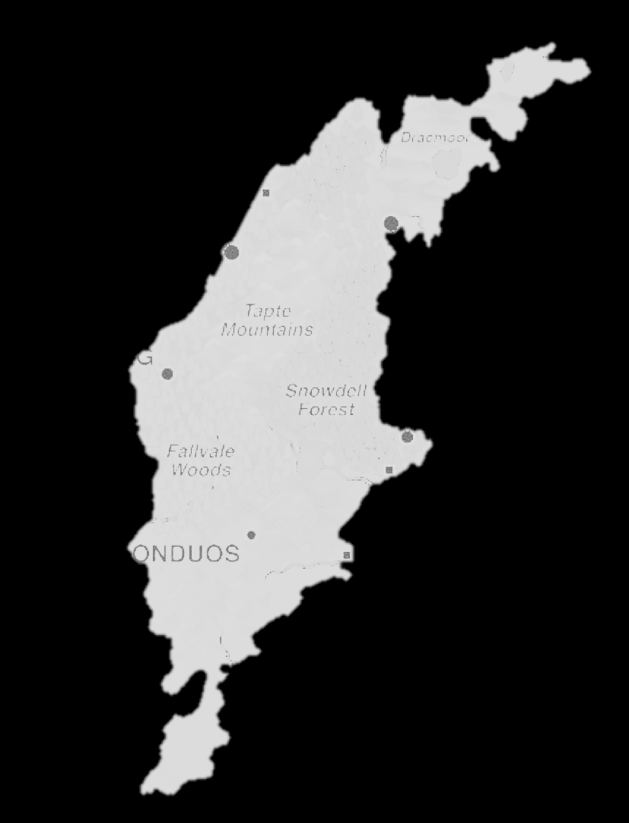
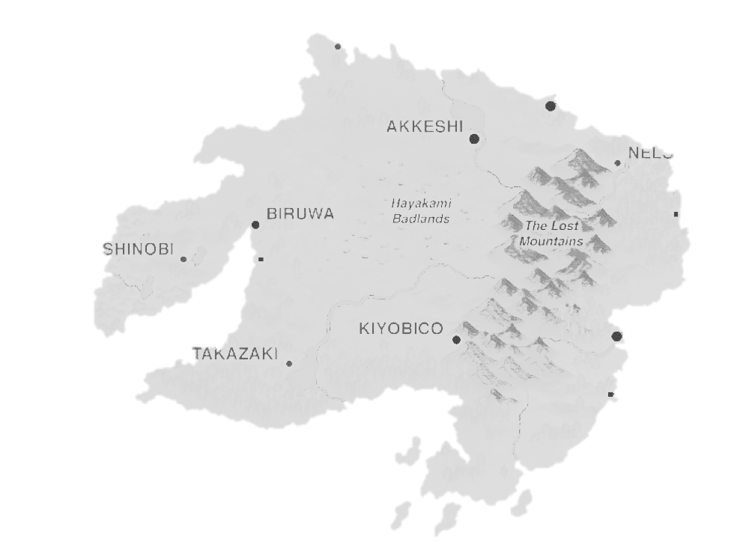
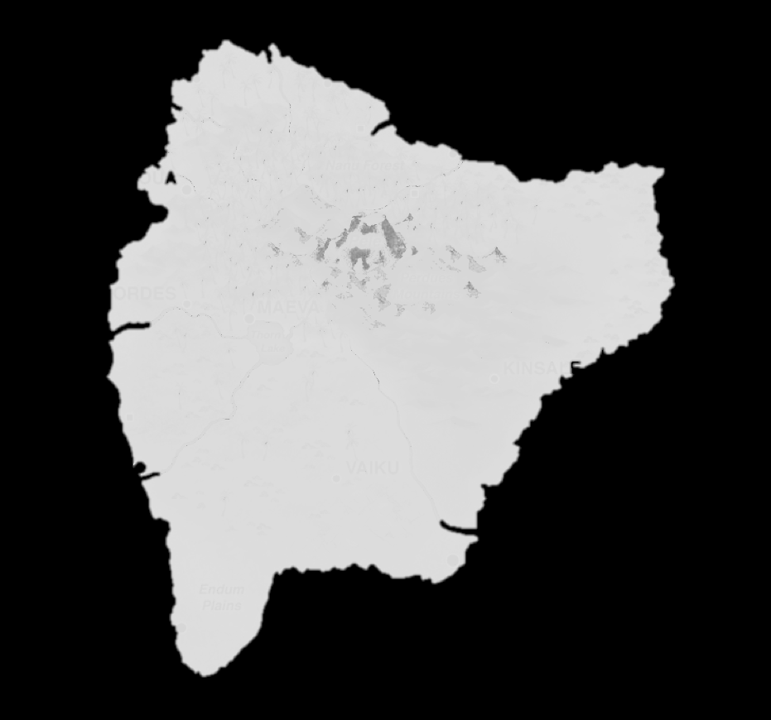
Randomized Sampling
Sample Pool

Slide 12
Randomly Stratified Sampling
72
HIWO | 36
LIWO | 36
Sample Pool
116
Gender: M/F
Age: 18~28/ 29~39/ 40~50
Starting BMI: Normal/ Overweight/ Overweight

Slide 13
Data Format
Name | Age | Gender | Treatment | Height1(m) | Weight1(kg) | Height2(m) | Weight2(kg) | Starting BMI
Alice | 22 | F | HIWO | 1.63 | 54 | 1.63 | 50 | Normal
Bruce | 35 | M | LIWO | 1.75 | 85 | 1.75 | 77 | Overweight

Slide 14
Planned Analysis Process
Perform
Analysis Methods
Explore the data
Test Assumptions

Slide 15
Data Analysis
Penny Zhang

Slide 16
Demographic Statistics - Any Differences?
No Differences at Baseline Next step: Assumption
 | HIWO | LIWO
Sample size | 35 | 31
Gender (Males : Females) | 17 : 18 | 15 : 16
BMI1 (mean ± SE) | 23.56 ± 2.00 | 22.68 ± 2.66
Age (18-28: 29-39:40-50) | 11:13:11 | 11:12:8
Age | 33.74 ± 9.45 | 33.10 ± 8.67

Slide 17
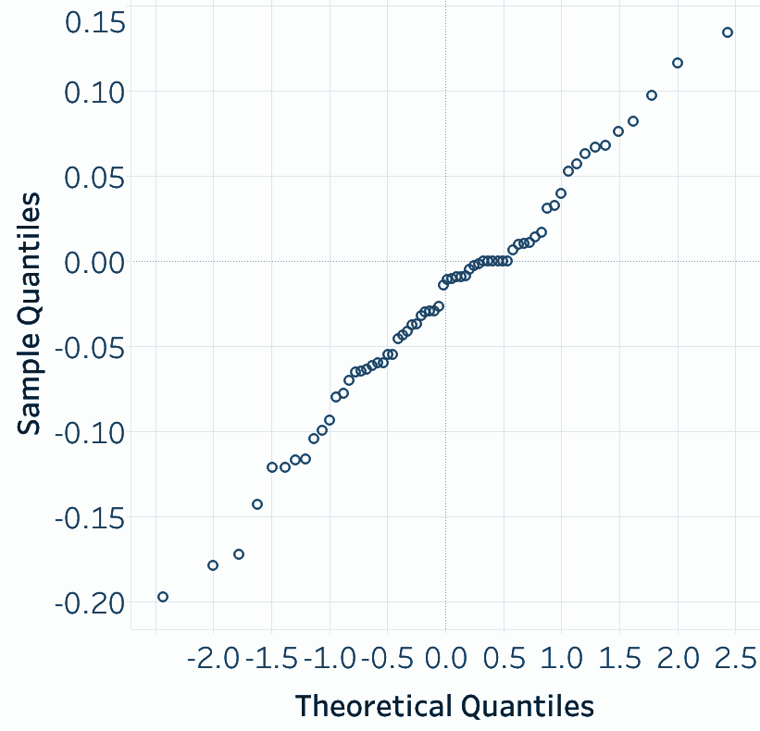
Assumption - Check independent & normality
The data satisfied two assumptions.
Next step: Boxplot
Independent
Randomly selected data from different cities and houses.
Normality
Normal Q-Q Plot

Slide 18
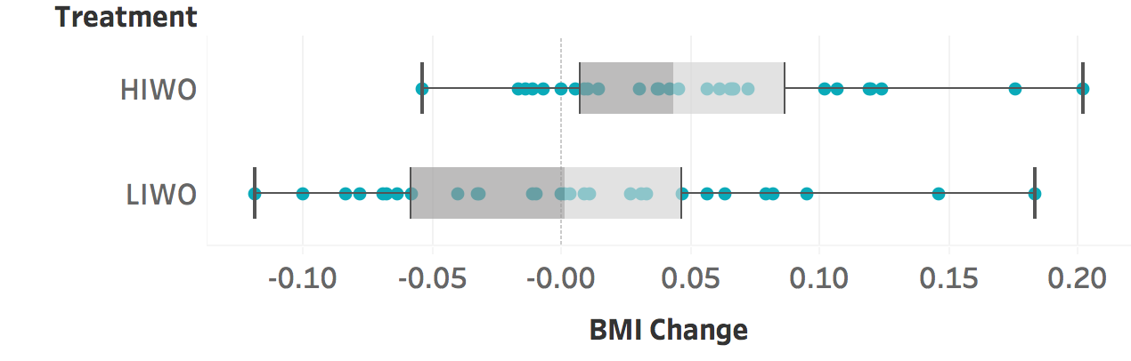
Boxplot of Treatments - Difference in two groups?
The BMI change mean is different in two groups.
Next step: Two-Sample T-test

Slide 19
0.043346
0.003164
0.016232
HIWO - BMI change mean
LIWO - BMI change mean
P-value

Slide 20
Two-Sample T-test - Significant?
Mean of HIWO: 0.043346 Mean of LIWO: 0.003164 P-value: 0.016232 < 0.05
The BMI change is not same in HIWO and LIWO groups.
Null Hypothesis: The BMI change is not same in HIWO and LIWO groups.
Alternative Hypothesis: The BMI change is not same in HIWO and LIWO groups.
Next step: Linear Model

Slide 21
Linear Model - Other variables?
Only Treatments (HIWO or LIWO) has effect on the change in BMI.
To test other variables and their relationship to the BMI difference
Treatment
P-value: 0.0187
Age
P-value: 0.3746
Gender
P-value: 0.7620

Slide 22
Bringing it all together
Stefani Weimholt

Slide 23
Discussion & Further Investigation
Statistical significance, but no clinical significance (0.0402< 0.5)
Time frame of study - Island time ≠ Real time
Further investigation
longer time period
increase treatment cadence

Slide 24
Our experience consulting
What went really well
We were all engaged
Positive communication
Group folder
Perfect team!
If we could go back in time…
Get better pilot data

Slide 25
Questions?

Slide 26
WORKOUT INTENSITY ON CHANGES IN BMI
Stefani Weimholt, Xiaomeng Huang & Penny Zhang
STAT 4893W - Group 6 - 4/26/2017

Slide 27
Introduction
Stefani Weimholt

Slide 28
Background
Obesity is linked to a multitude of health concerns
BMI = weight/height² = kg/m²
Underweight | Normal | Overweight | Obese
18.5 < BMI | 18.5 ≤ BMI ≤ 24.9 | 18.5 ≤ BMI ≤ 29.9 | BMI ≥ 30
Source: www.cdc.gov
How to best maintain a normal BMI?
Notes:
Underweight: BMI is less than 18.5
Normal weight: BMI is 18.5 to 24.9
Overweight: BMI is 25 to 29.9
Obese: BMI is 30 or more

Slide 29
Current Studies
positive effects of aerobic training on weight loss are independent of exercise intensity (Branch et al., 2000; Jakicic et al., 2003)
BMI was equally reduced in both the low and high exercise intensity
(Botero et al., 2014)
high-intensity exercise training significantly reduced total fat, while low-intensity exercise training did not produce any relevant effect on fat leading researchers to believe a higher reduction in BMI is plausible with high intensity exercise (Irving et al., 2008)

Slide 30
Study Objective
Does the intensity of workouts affect one’s change in BMI?

Slide 31
Study Design
Xiaomeng Huang

Slide 32
WHAT
Study Population; Design; Primary Response
HOW
Methods; Sample

Slide 33
Clinical
Study Population
Adults 18~50, BMI≥18.5, not pregnant, not handicapped
Design
Workout 2x a week for 2 weeks
HIWO - 1500m
LIWO - 30 min relaxed walk🚶
Primary Response
Difference in BMI change for two groups
2nd Gender; Age

Slide 34
Planned Analysis Methods
Two Sample T-test
Change in BMI: HIWO = LIWO V.S. HIWO ≠ LIWO
Linear Model
Change in BMI ~ Treatment + Age + Gender
Nonparametric Method
Wilcoxon signed test

Slide 35
Sample Size
PILOT
starting BMI
LIWO
HIWO
WANTED
difference in BMI change
72
Meaningful clinical difference: 0.5
Significance level: 0.05; Power: 0.8

Slide 36
Randomized Sampling
Sample Pool

Slide 37
Randomly Stratified Sampling
72
HIWO | 36
LIWO | 36
Sample Pool
116
Gender: M/F
Age: 18~28/ 29~39/ 40~50
Starting BMI: Normal/ Overweight/ Overweight

Slide 38
Data Format
Name | Age | Gender | Treatment | Height1(m) | Weight1(kg) | Height2(m) | Weight2(kg) | Starting BMI
Alice | 22 | F | HIWO | 1.63 | 55 | 1.63 | 53 | Normal
Bruce | 35 | M | LIWO | 1.75 | 88 | 1.75 | 80 | Overweight

Slide 39
Planned Analysis Process
Perform
Analysis Methods
Explore the data
Test Assumptions

Slide 40
Data Analysis
Penny Zhang

Slide 41
Demographic Statistics - Any Differences?
No Differences at Baseline Next step: Assumption
 | HIWO | LIWO
Sample size | 35 | 31
Gender (Males : Females) | 17 : 18 | 15 : 16
BMI1 (mean ± SE) | 23.56 ± 2.00 | 22.68 ± 2.66
Age (18-28: 29-39:40-50) | 11:13:11 | 11:12:8
Age | 33.74 ± 9.45 | 33.10 ± 8.67

Slide 42
Assumption - Check independent & normality
The data satisfied two assumptions.
Next step: Boxplot
Independent
Randomly selected data from different cities and houses.
Normality
Normal Q-Q Plot

Slide 43
Boxplot of Treatments - Difference in two groups?
The BMI change mean is different in two groups.
Next step: Two-Sample T-test

Slide 44
0.043346
0.003164
0.016232
HIWO - BMI change mean
LIWO - BMI change mean
P-value

Slide 45
Two-Sample T-test - Significant?
Mean of HIWO: 0.043346 Mean of LIWO: 0.003164 P-value: 0.016232 < 0.05
The BMI change is not same in HIWO and LIWO groups.
Null Hypothesis: The BMI change is not same in HIWO and LIWO groups.
Alternative Hypothesis: The BMI change is not same in HIWO and LIWO groups.
Next step: Linear Model

Slide 46
Linear Model - Other variables?
Only Treatments (HIWO or LIWO) has effect on the change in BMI.
To test other variables and their relationship to the BMI difference
Treatment
P-value: 0.0187
Age
P-value: 0.3746
Gender
P-value: 0.7620

Slide 47
Bringing it all together
Stefani Weimholt

Slide 48
Discussion & Further Investigation
Statistical significance, but no clinical significance (0.0402< 0.5)
Time frame of study - Island time ≠ Real time
Further investigation
longer time period
increase treatment cadence

Slide 49
Our experience consulting
What went really well
We were all engaged
Positive communication
Group folder
Perfect team!
If we could go back in time…
Get better pilot data

Slide 50
Questions?

